Slide 1
Sorting and Searching

Slide 2
Sorting and Searching Algorithms
Selection Sort
Bubble Sort
Insertion Sort
Merge Sort
Heap Sort
Quick Sort

Slide 3
Sorting Algorithms and Memory
Some algorithms sort by swapping elements within the input array
Such algorithms are said to sort in place, and require only O(1) additional memory.
Other algorithms require allocation of an output array into which values are copied.
These algorithms do not sort in place, and require O(n) additional memory.
4 3 7 11 2 2 1 3 5
swap

Slide 4
Selection Sort
Selection Sort operates by first finding the smallest element in the input list, and moving it to the output list.
It then finds the next smallest value and does the same.
It continues in this way until all the input elements have been selected and placed in the output list in the correct order.
Note that every selection requires a search through the input list.
Thus the algorithm has a nested loop structure
Selection Sort Example

Slide 5
Bubble Sort
Bubble Sort operates by successively comparing adjacent elements, swapping them if they are out of order.
At the end of the first pass, the largest element is in the correct position.
A total of n passes are required to sort the entire array.
Thus bubble sort also has a nested loop structure
Bubble Sort Example

Slide 6
Bubble Sort
for i = n-2 downto 0 for j = 0 to i
if A[ j ] > A[ j + 1 ]
swap A[ j ] and A[ j + 1 ]
O(i)
n − 2
T (n) = ∴ i = O(n² )
i = 0

Slide 7
Comparison
Thus both Selection Sort and Bubble Sort have O(n²) running time.
However, both can also easily be designed to
Sort in place
Stable sort

Slide 8
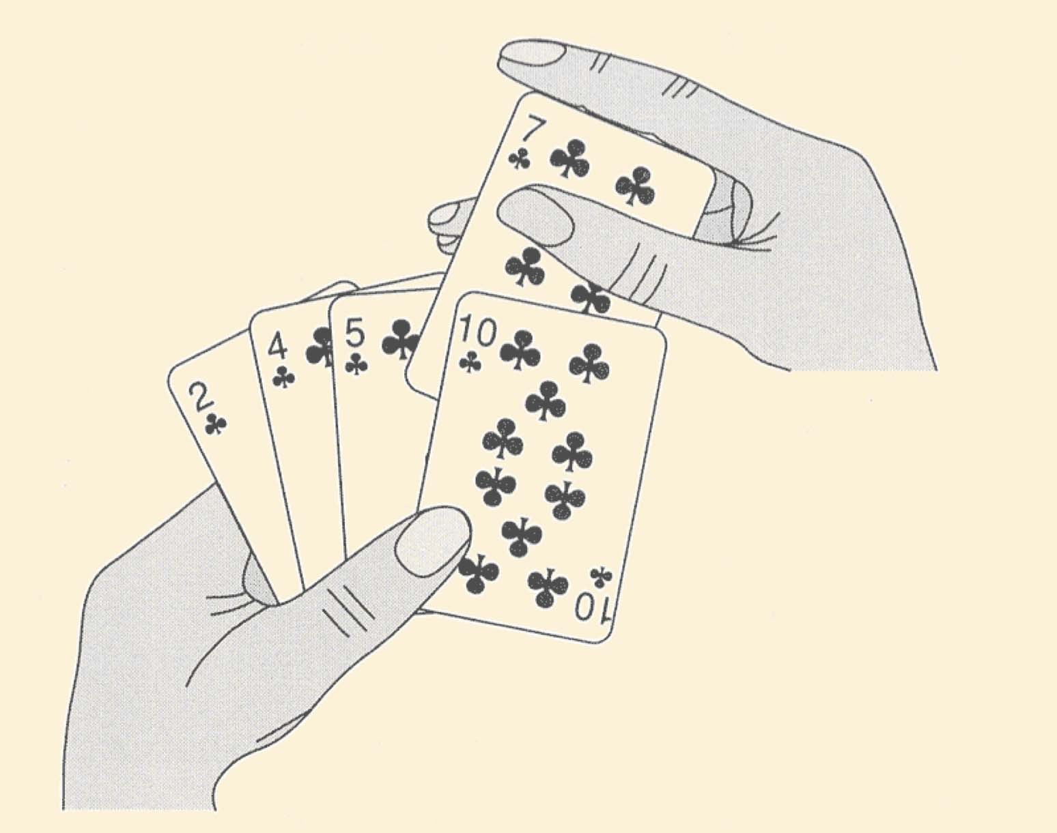
Example: Insertion Sort

Slide 9
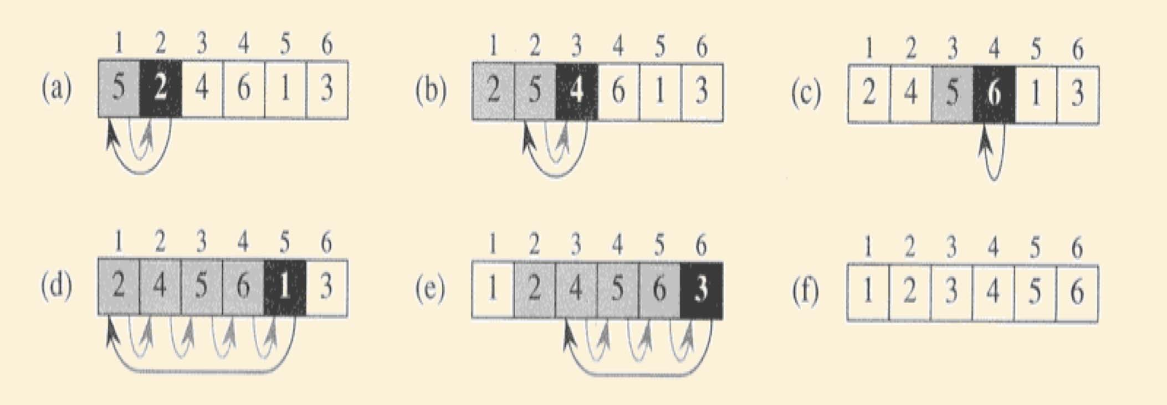
Example: Insertion Sort

Slide 10
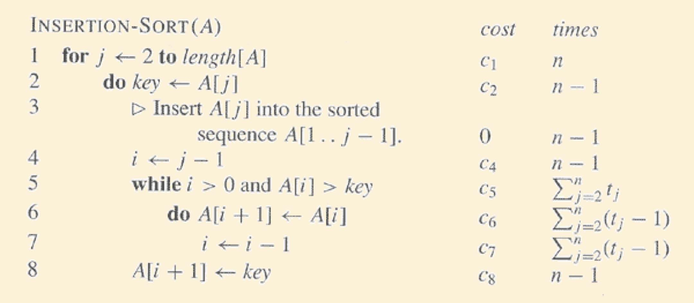
Example: Insertion Sort

Slide 11
Comparison
Selection Sort
Bubble Sort
Insertion Sort
Sort in place
Stable sort
But O(n²) running time.
Can we do better?

Slide 12

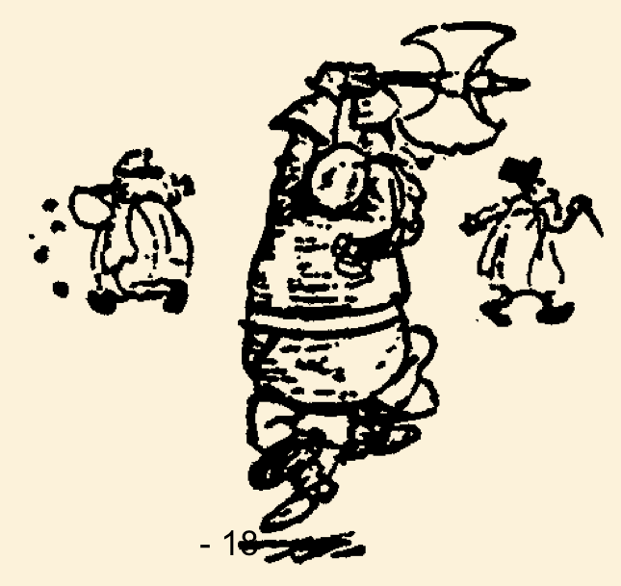
Merge Sort
88 52
31 ₂₅ ₉₈
62
14
30
79
23
Divide and Conquer

Slide 13
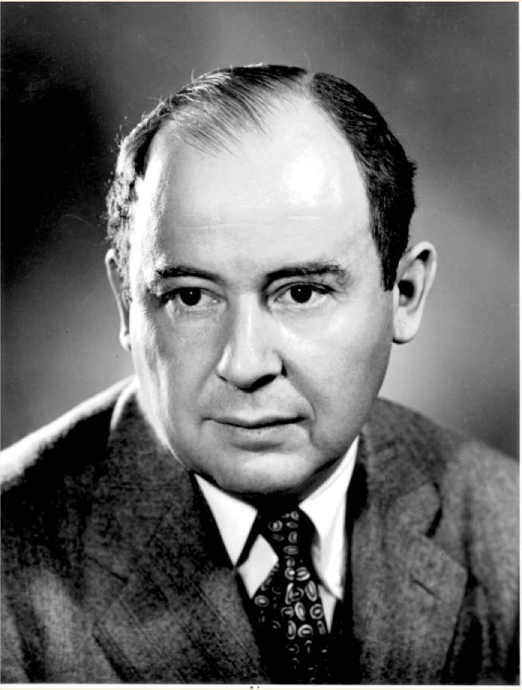
Merge Sort
Merge-sort is a sorting algorithm based on the divide- and-conquer paradigm
It was invented by John von Neumann, one of the pioneers of computing, in 1945

Slide 14
Divide-and-Conquer
Divide-and conquer is a general algorithm design paradigm:
Divide: divide the input data S in two disjoint subsets S₁ and S₂
Recur: solve the subproblems associated with S₁ and S₂
Conquer: combine the solutions for S₁ and S₂ into a solution for S
The base case for the recursion are subproblems of size 0 or 1

Slide 15
Merge Sort
Merge two sorted lists into one
25,31,52,88,98
14,23,25,30,31,52,62,79,88,98
14,23,30,62,79

Slide 16
Merge-Sort
Merge-sort on an input sequence S with n elements consists of three steps:
Divide: partition S into two sequences S₁ and S₂ of about n/2
elements each
Recur: recursively sort S₁ and S₂
Conquer: merge S₁ and S₂ into a unique sorted sequence
Algorithm mergeSort(S)
Input sequence S with n elements
Output sequence S sorted
if S.size() > 1
(S₁, S₂) € split(S, n/2) mergeSort(S₁) mergeSort(S₂) merge(S₁, S_{2,} S)

Slide 17
Merging Two Sorted Sequences
The conquer step of merge-sort consists of merging two sorted sequences A and B into a sorted sequence S containing the union of the elements of A and B
Merging two sorted sequences, each with n/2 elements takes O(n)
time
Normally, merging is not in-place: new memory must be allocated to hold S.
It is possible to do in-place merging using linked lists.
Code is more complicated
Only changes memory usage by a constant factor

Slide 18
Merging Two Sorted Sequences (As Arrays)
Algorithm merge(S₁, S₂, S):
Input: Sorted sequences S₁ and S₂ and an empty sequence S, implemented as arrays
Output: Sorted sequence S containing the elements from S₁ and S₂
i → j → 0
while i < S₁.size() and j < S₂.size() do if S₁.get(i) Σ S₂.get(j) then
S.addLast(S₁.get(i))
i → i + 1
else
S.addLast(S₂.get(j)) j → j + 1
while i < S₁.size() do
S.addLast(S₁.get(i)) i → i + 1
while j < S₂.size() do S.addLast(S₂.get(j)) j → j + 1

Slide 19
Merging Two Sorted Sequences (As Linked Lists)
Algorithm merge(S₁, S₂, S):
Input: Sorted sequences S₁ and S₂ and an empty sequence S, implemented as linked lists
Output: Sorted sequence S containing the elements from S₁ and S₂
while S₁ σ¬ and S₂ σ¬ do
if S₁.first().element() Σ S₂.first().element() then
S.addLast(S₁.remove(S₁.first())) i → i + 1
else
S.addLast(S₂.remove(S₂.first()))
while S₁ σ¬ do
S.addLast(S₁.remove(S₁.first()))
while S₂ σ¬ do
S.addLast(S₂.remove(S₂.first()))

Slide 20
Merge-Sort Tree
An execution of merge-sort is depicted by a binary tree
each node represents a recursive call of merge-sort and stores
 unsorted sequence before the execution and its partition
 sorted sequence at the end of the execution
the root is the initial call
the leaves are calls on subsequences of size 0 or 1
7 2 | 9 4 € 2 4 7 9
7 | 2 € 2 7
9 | 4 € 4 9
7 €  7
2 €  2
9 €  9
4 €  4

Slide 21
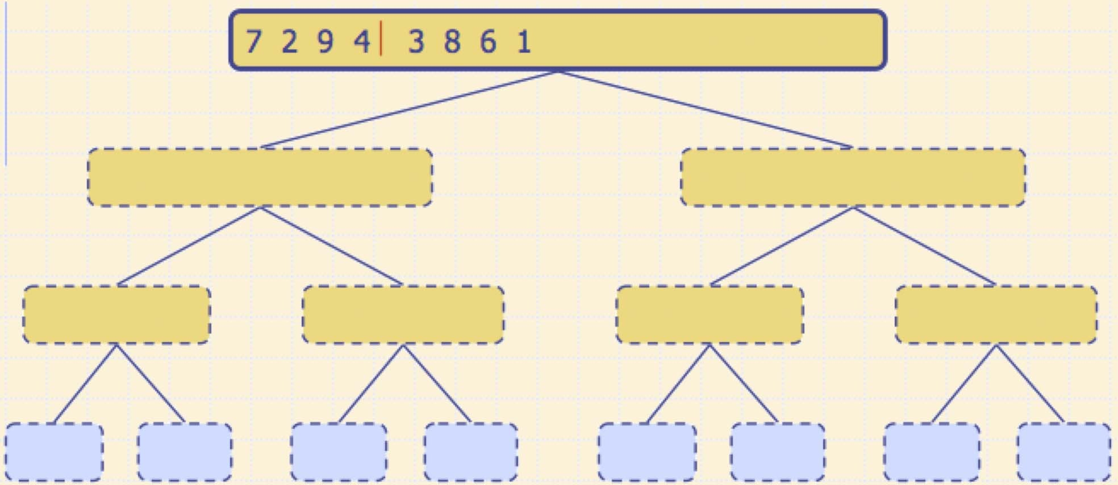
Execution Example
Partition

Slide 22
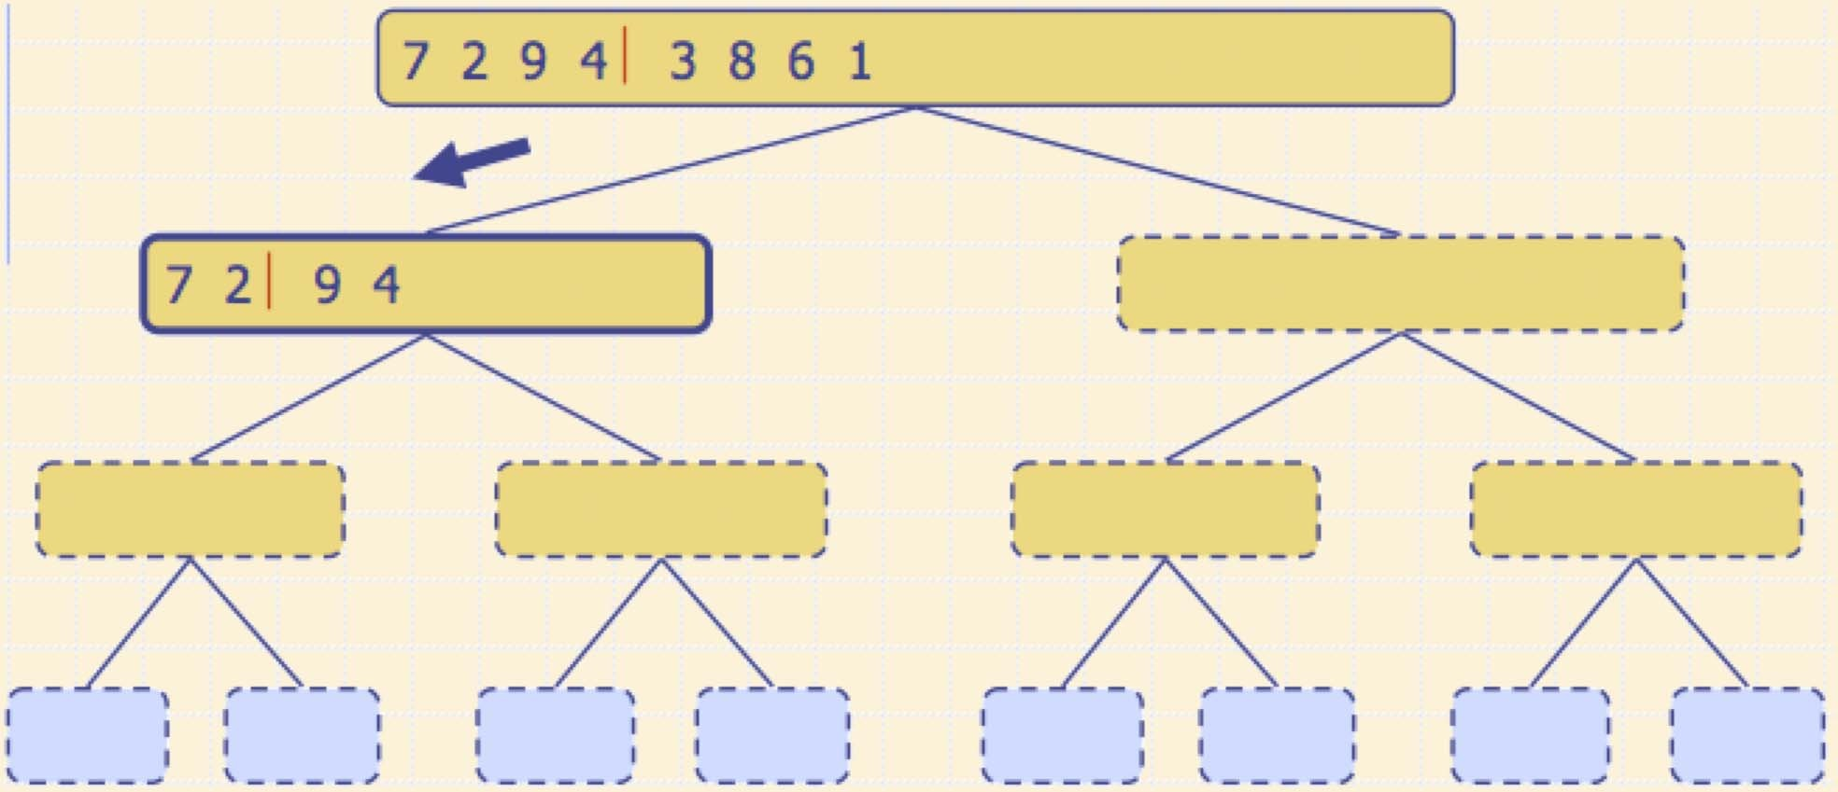
Execution Example (cont.)
Recursive call, partition

Slide 23
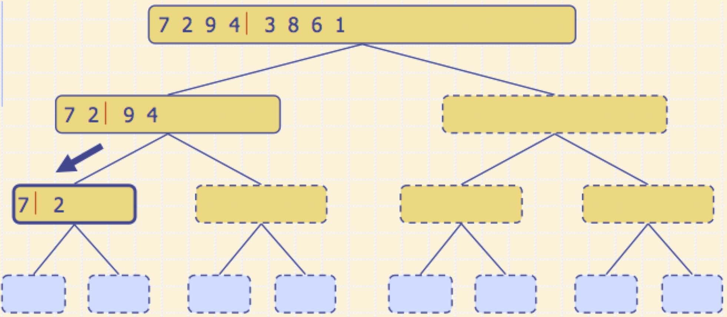
Execution Example (cont.)
Recursive call, partition

Slide 24
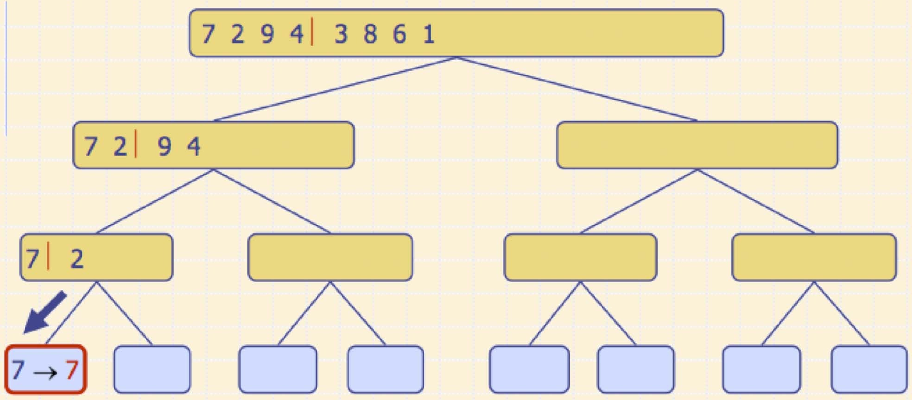
Execution Example (cont.)
Recursive call, base case

Slide 25
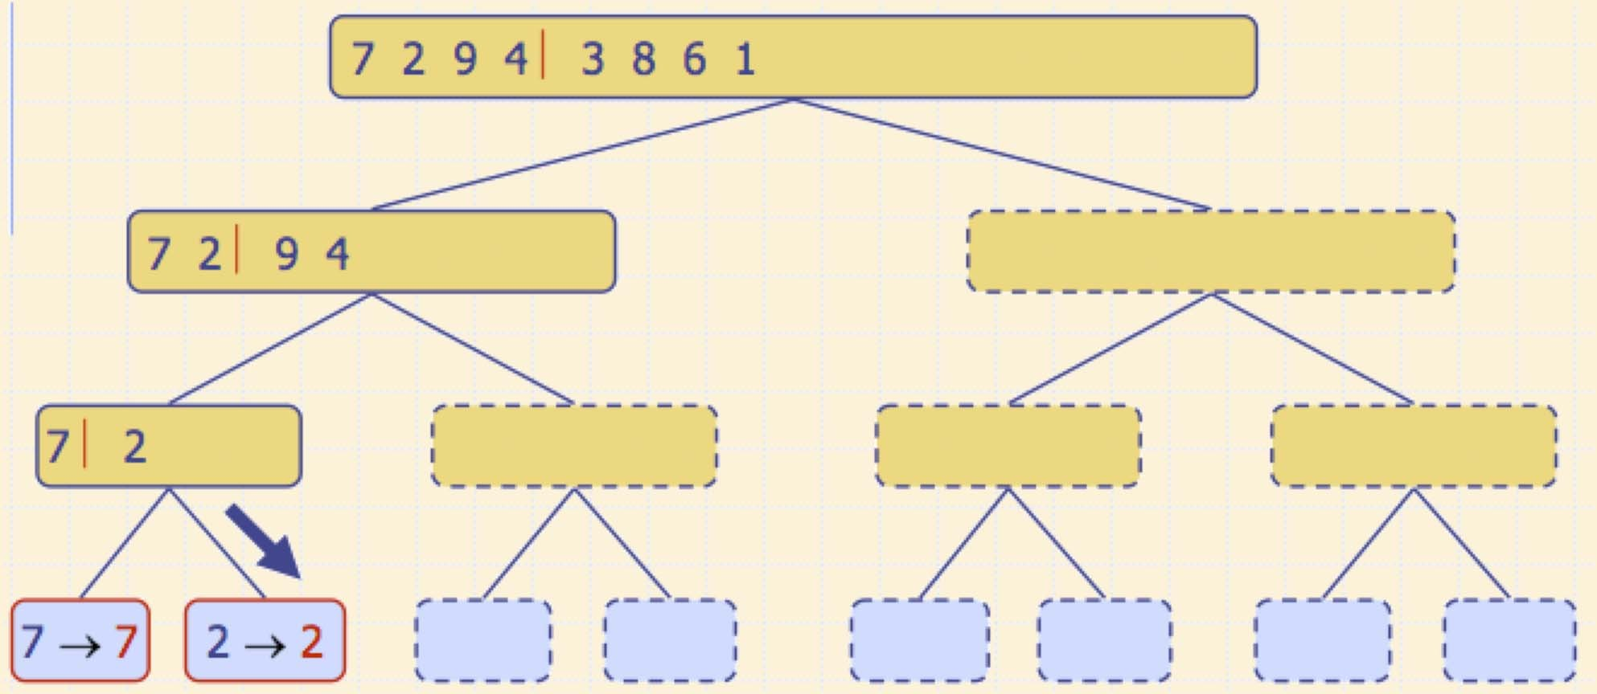
Execution Example (cont.)
Recursive call, base case

Slide 26
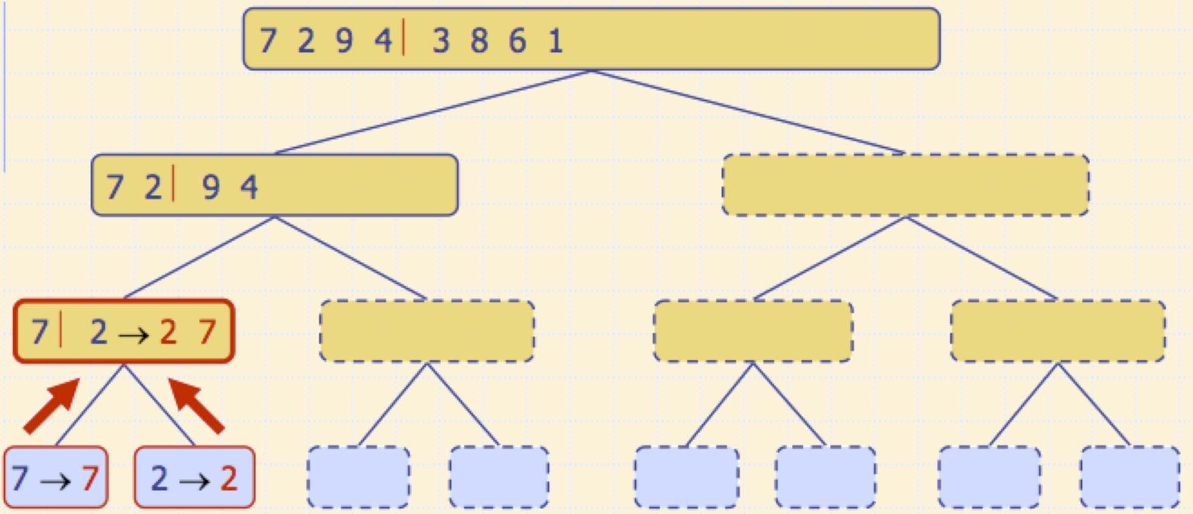
Execution Example (cont.)
Merge

Slide 27
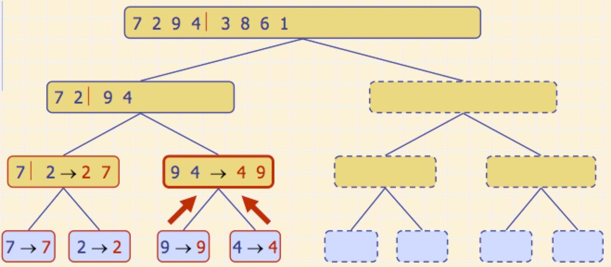
Execution Example (cont.)
Recursive call, …, base case, merge

Slide 28
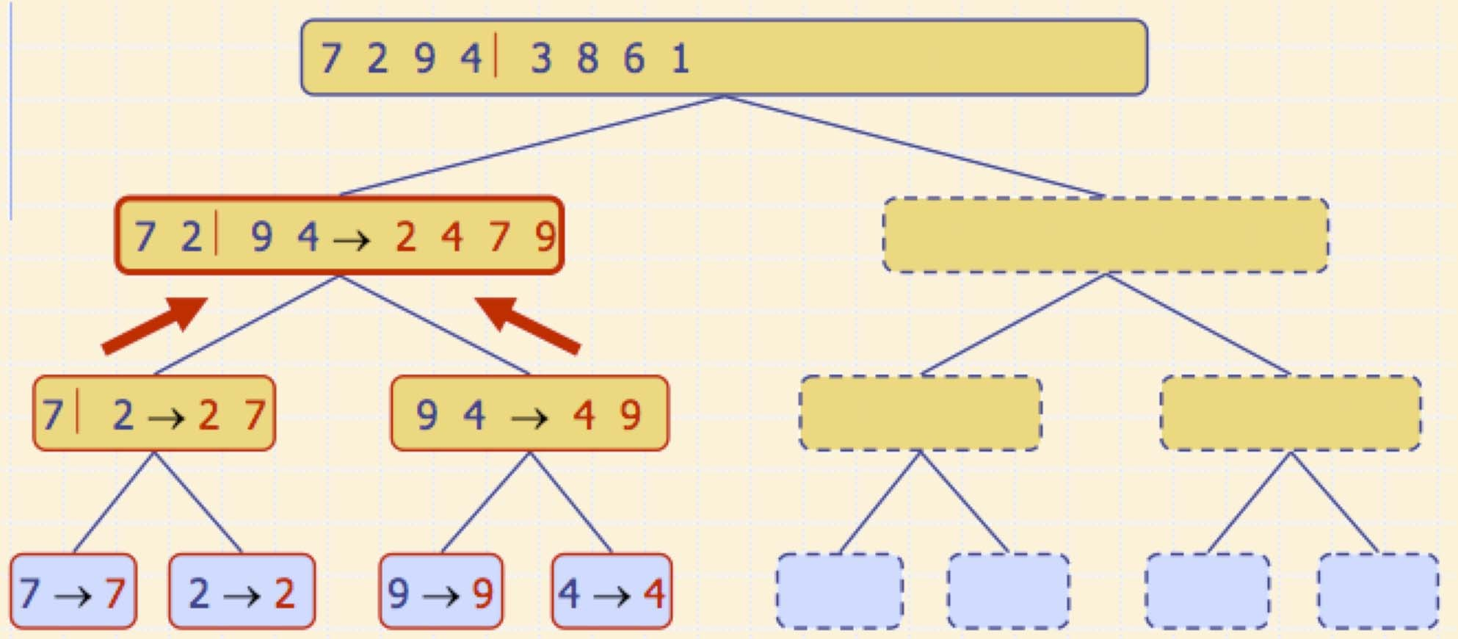
Execution Example (cont.)
Merge

Slide 29
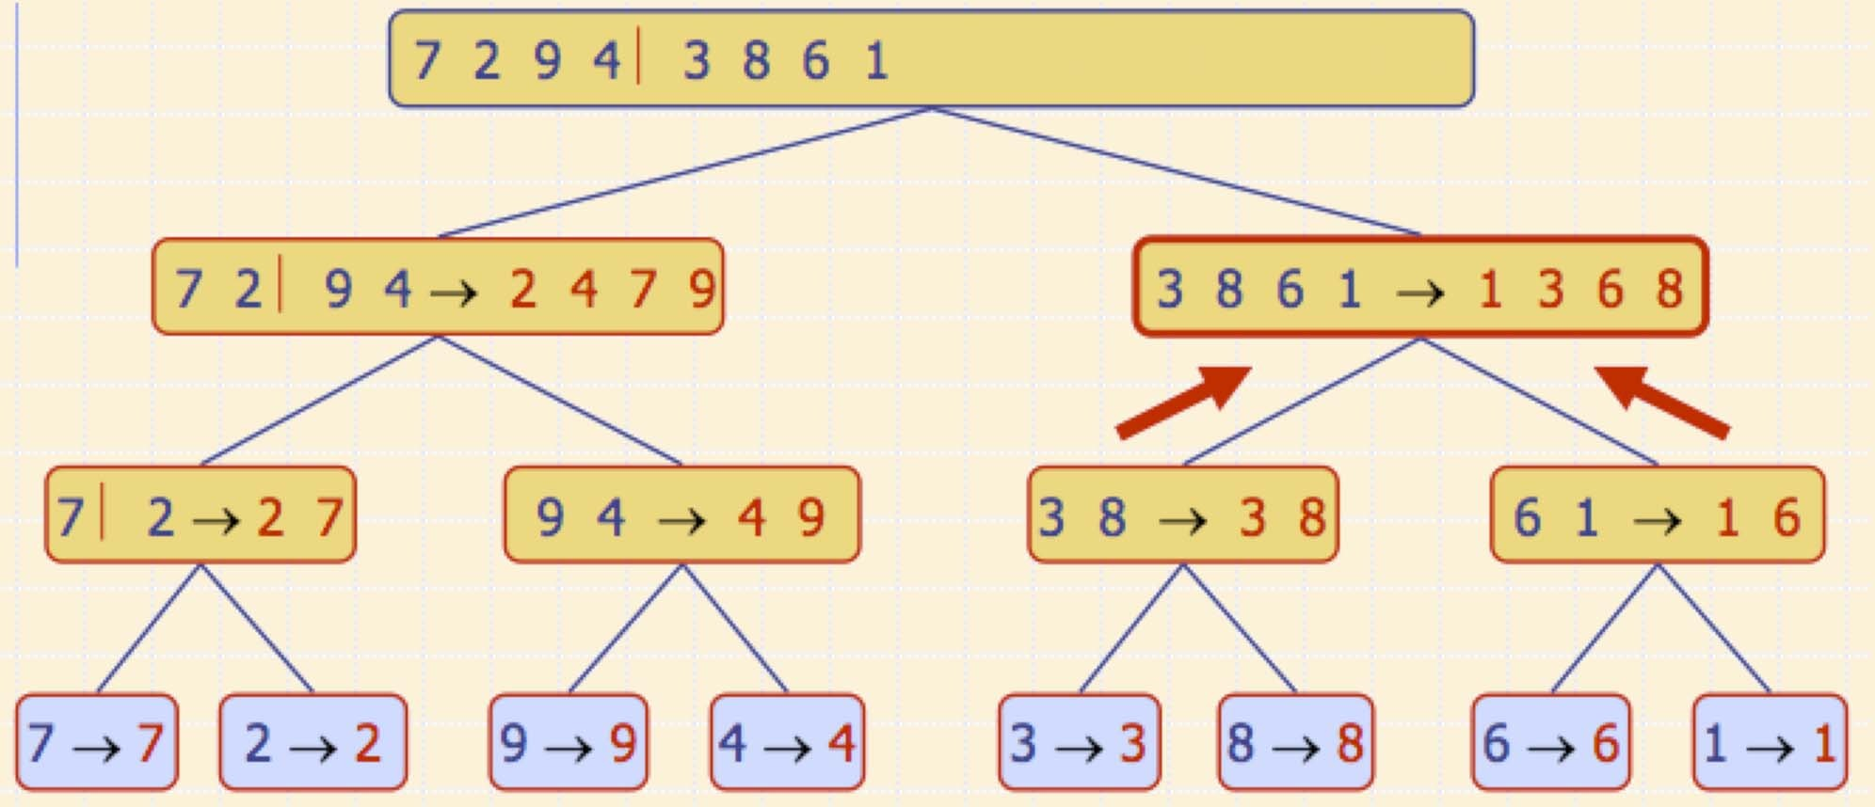
Execution Example (cont.)
Recursive call, …, merge, merge

Slide 30
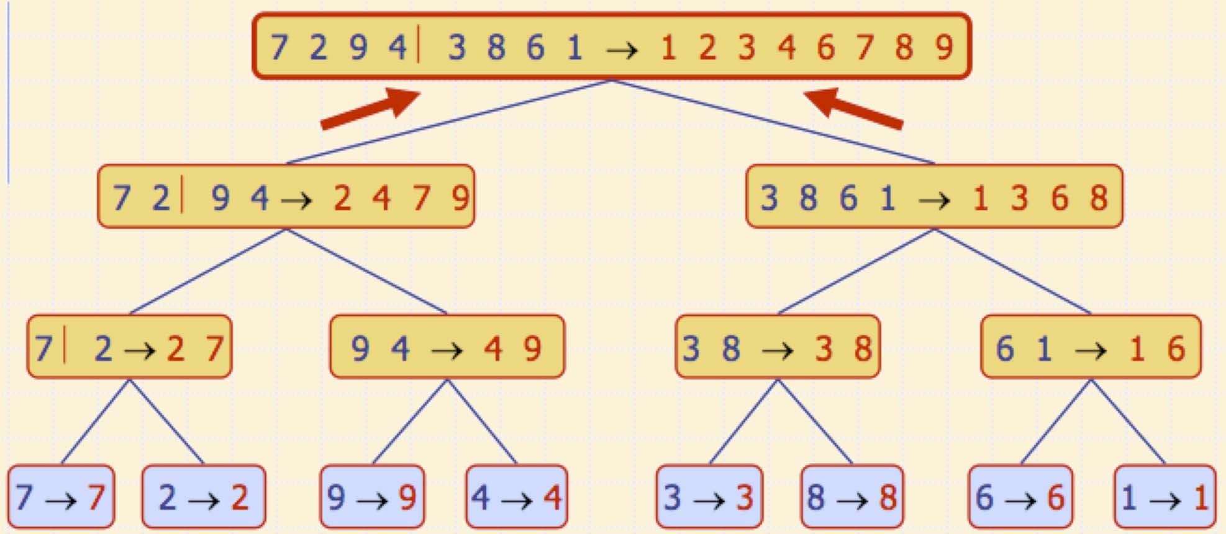
Execution Example (cont.)
Merge

Slide 31
Analysis of Merge-Sort
The height h of the merge-sort tree is O(log n)
at each recursive call we divide in half the sequence,
The overall amount or work done at the nodes of depth i is O(n)
we partition and merge 2^{i} sequences of size n/2^{i}
we make 2^{i+1} recursive calls
Thus, the total running time of merge-sort is O(n log n)
depth #seqs size
0 1 n
1 2 n/2 n/2^{i}
T (n) = 2T (n / 2) + O(n)
i
₂i
…
…
…

Slide 32
Heapsort
Invented by Williams & Floyd in 1964
O(nlogn) worst case – like merge sort
Sorts in place – like insertion sort
Combines the best of both algorithms

Slide 33
Selection Sort
Largest i values are sorted on the right. Remaining values are off to the left.
3 5
1
4
<
6,7,8,9
2
Max is easier to find if a heap.

Slide 34
Heap-Sort Algorithm
Build an array-based (max) heap
Iteratively call removeMax() to extract the keys in descending order
Store the keys as they are extracted in the unused tail portion of the array

Slide 35
Heap-Sort Algorithm
Algorithm HeapSort(S)
Input: S, an unsorted array of comparable elements
Output: S, a sorted array of comparable elements T = MakeMaxHeap (S)
for i = n-1 downto 1
S[i] = T.removeMax()

Slide 36
Heap-Sort Running Time
The heap can be built bottom-up in O(n) time
Extraction of the ith element takes O(log(n - i+1)) time (for downheaping)
Thus total run time is
n
T (n) = O(n) + ∴log(n − i + 1)
i =1
n
= O(n) + ∴log i
i =1
n
Σ O(n) + ∴log n
i =1
= O(n log n)

Slide 37

Quick-Sort
88 52
31 ₂₅ ₉₈
62
14
30
79
23
Divide and Conquer

Slide 38

QuickSort
Invented by C.A.R. Hoare in 1960
“There are two ways of constructing a software design: One way is to make it so simple that there are obviously no deficiencies, and the other way is to make it so complicated that there are no obvious deficiencies. The first method is far more difficult.”

Slide 39
Quick-Sort
Quick-sort is a divide-and- conquer algorithm:
Divide: pick a random element x (called a pivot) and partition S into
 L elements less than x
 E elements equal to x
 G elements greater than x
Recur: Quick-sort L and G
Conquer: join L, E and G
x
x
L
E
G
x

Slide 40
The Quick-Sort Algorithm
Algorithm QuickSort(S) if S.size() > 1
(L, E, G) = Partition(S) QuickSort(L) QuickSort(G)
S = (L, E, G)

Slide 41
Partition
Remove, in turn, each element y from S and
Insert y into sequence L, E or G, depending on the result of the comparison with the pivot x (e.g., last element in S)
Each insertion and removal is at the beginning or at the end of a sequence, and hence takes O(1) time
Thus, partitioning takes
O(n) time
Algorithm Partition(S)
Input sequence S
Output subsequences L, E, G of the elements of S less than, equal to, or greater than the pivot, resp.
L, E, G € empty sequences x € S.getLast().element while ¬S.isEmpty()
y € S.removeFirst(S)
if y < x
L.addLast(y)
else if y = x
E.addLast(y)
else { y > x }
G.addLast(y)
return L, E, G

Slide 42
Partition
Since elements are removed at the beginning and added at the end, this partition algorithm is stable.
Algorithm Partition(S)
Input sequence S
Output subsequences L, E, G of the elements of S less than, equal to, or greater than the pivot, resp.
L, E, G € empty sequences x € S.getLast().element while ¬S.isEmpty()
y € S.removeFirst(S)
if y < x
L.addLast(y)
else if y = x
E.addLast(y)
else { y > x }
G.addLast(y)
return L, E, G

Slide 43
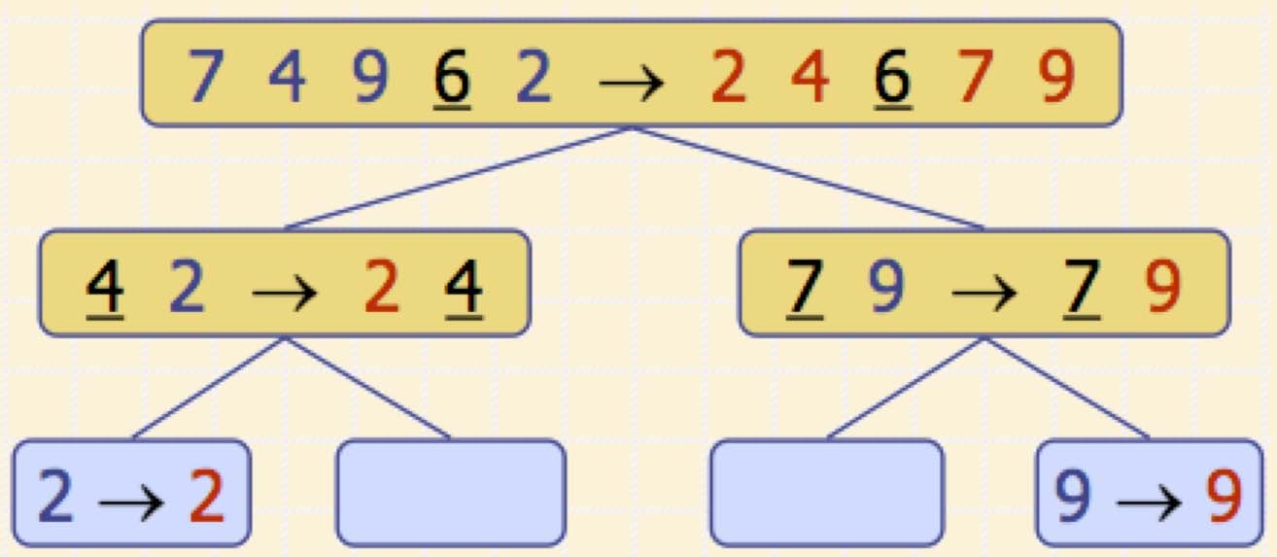
Quick-Sort Tree
An execution of quick-sort is depicted by a binary tree
Each node represents a recursive call of quick-sort and stores
 Unsorted sequence before the execution and its pivot
 Sorted sequence at the end of the execution
The root is the initial call
The leaves are calls on subsequences of size 0 or 1

Slide 44
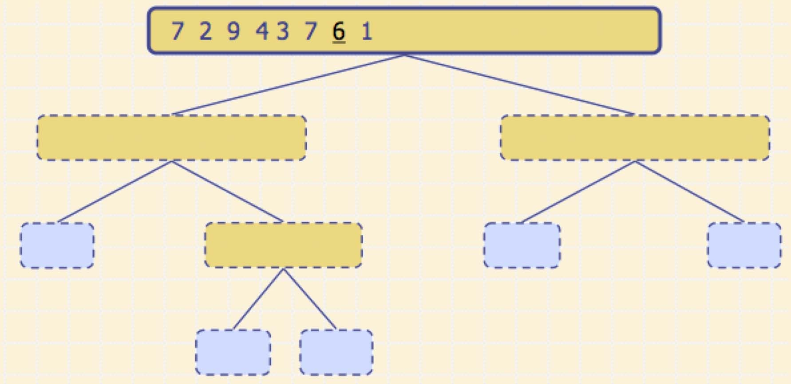
Execution Example
Pivot selection

Slide 45
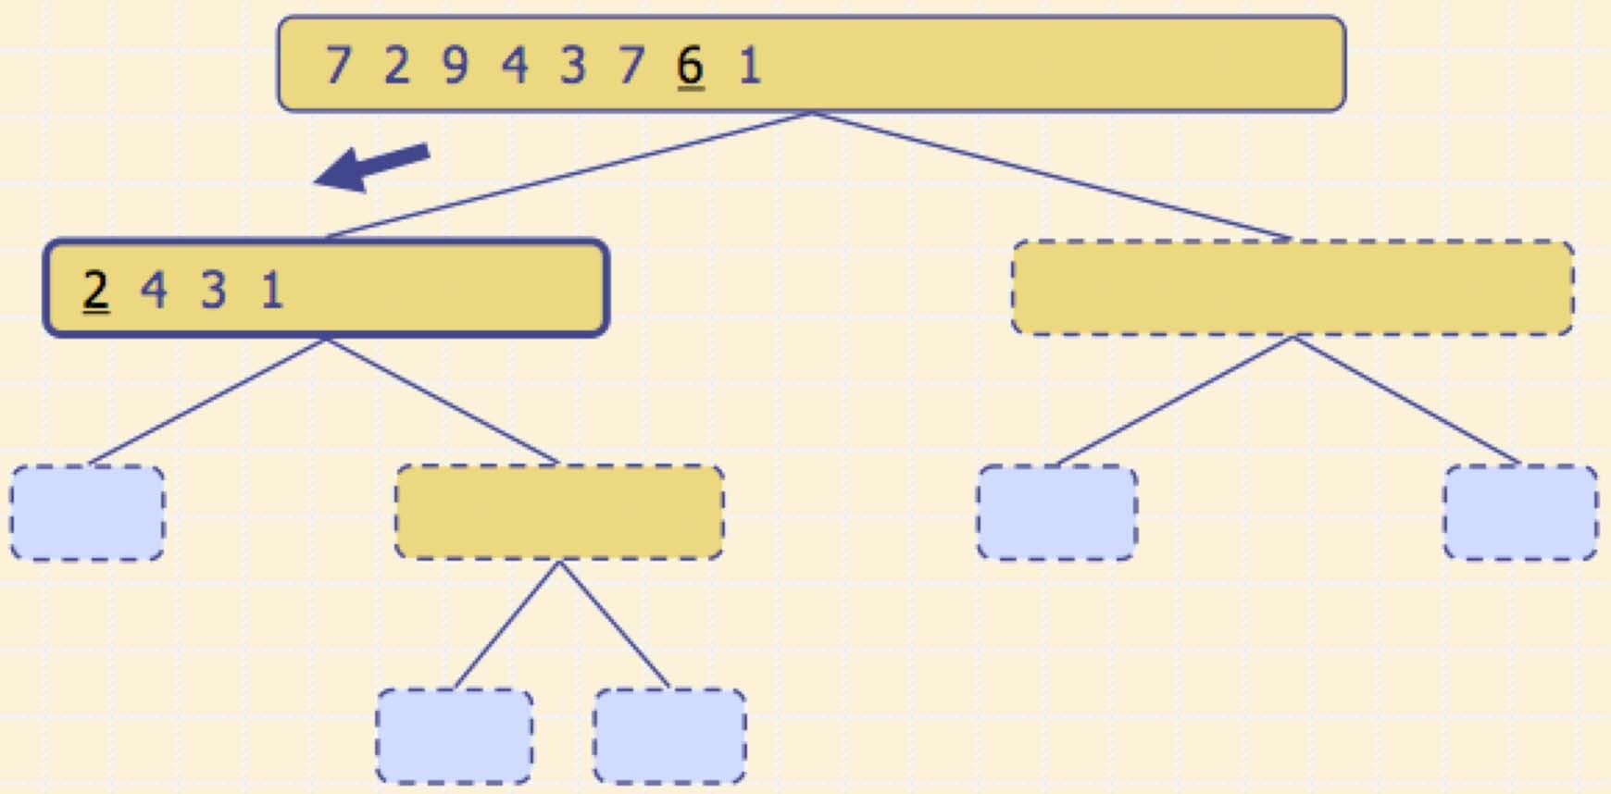
Execution Example (cont.)
Partition, recursive call, pivot selection

Slide 46
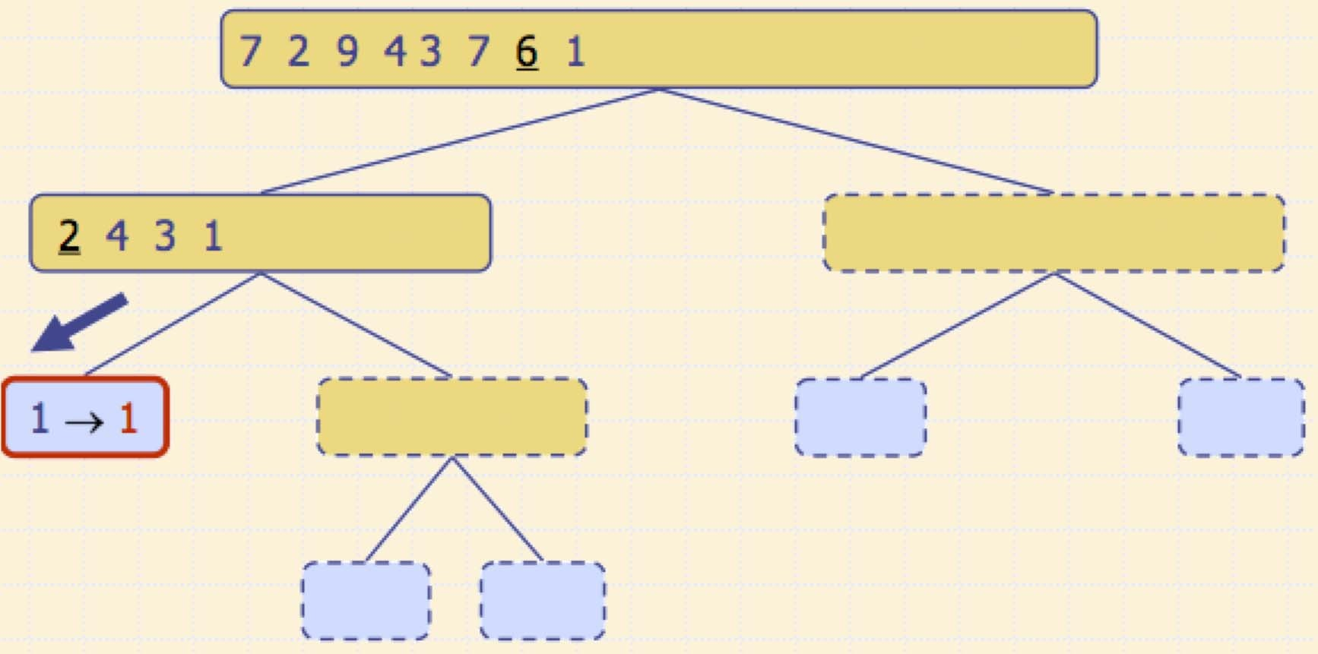
Execution Example (cont.)
Partition, recursive call, base case

Slide 47
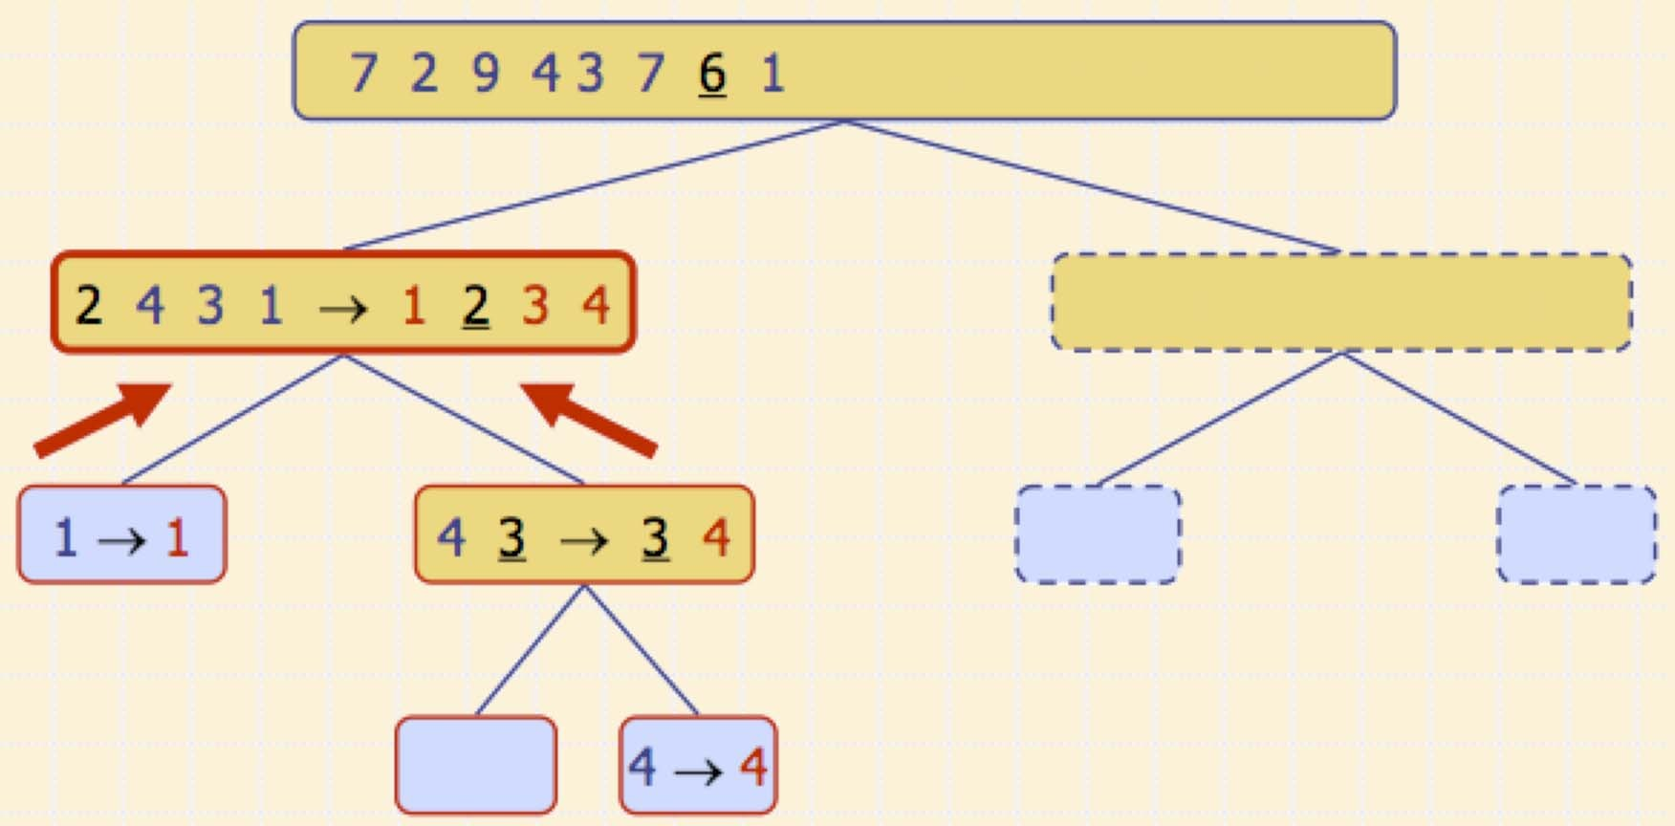
Execution Example (cont.)
Recursive call, …, base case, join

Slide 48
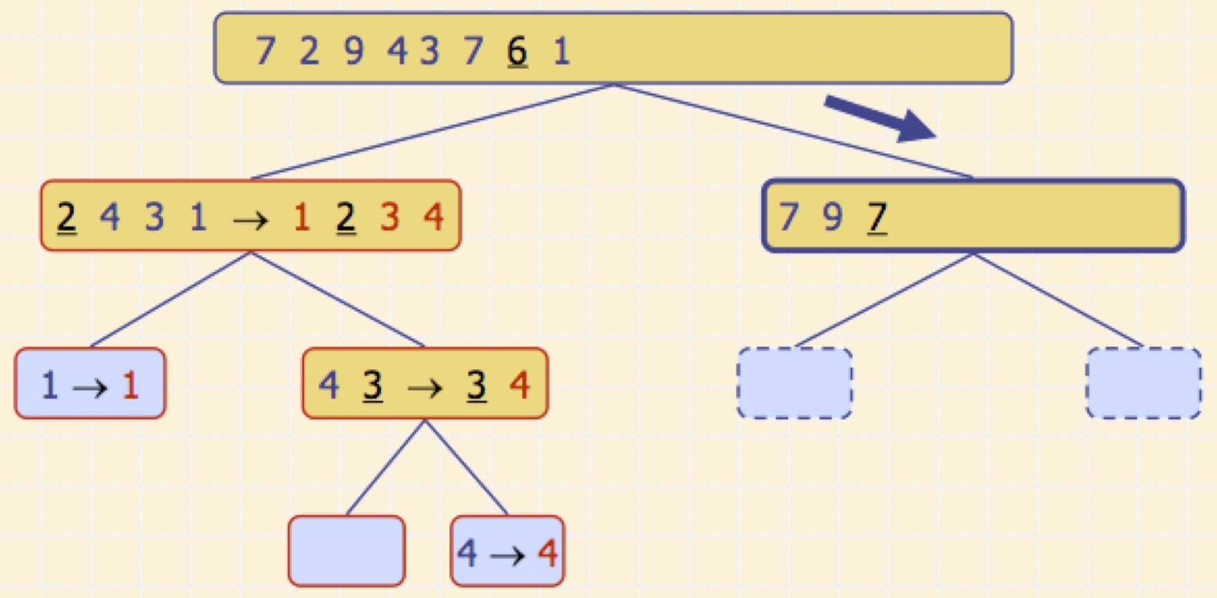
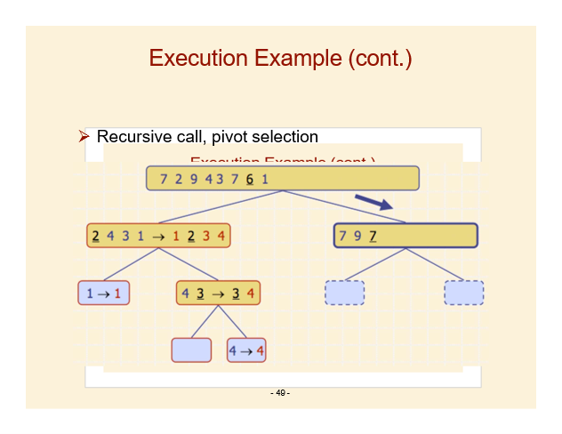
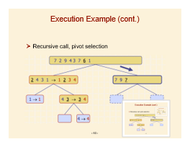
Execution Example (cont.)
Recursive call, pivot selection

Slide 49
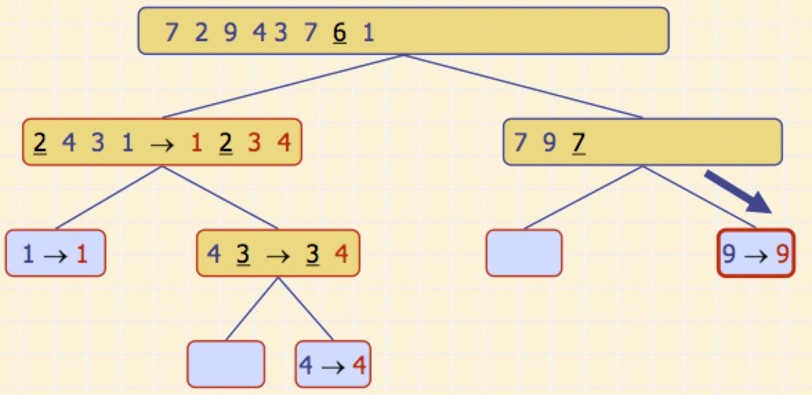
Execution Example (cont.)
Partition, …, recursive call, base case

Slide 50
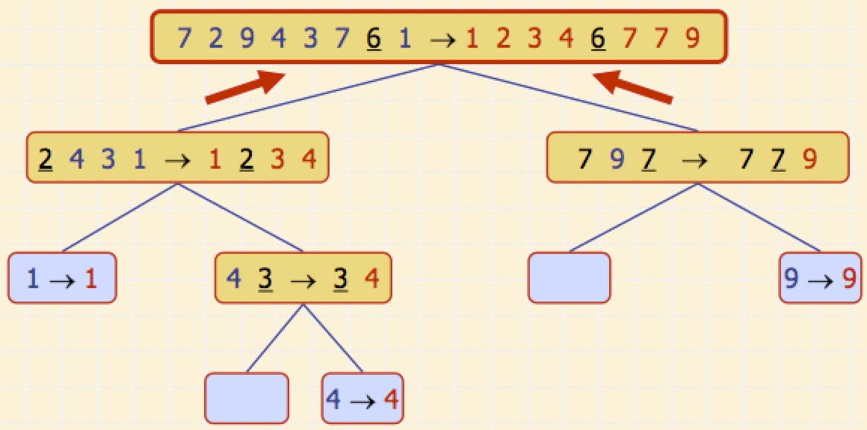
Execution Example (cont.)
Join, join

Slide 51
Quick-Sort Properties
The algorithm just described is stable, since elements are removed from the beginning of the input sequence and placed on the end of the output sequences (L,E, G).
However it does not sort in place: O(n) new memory is allocated for L, E and G
Is there an in-place quick-sort?

Slide 52
In-Place Quick-Sort
Note: Use the lecture slides here instead of the textbook implementation (Section 11.2.2)
Partition set into two using randomly chosen pivot
88 52
31 ₂₅ ₉₈
62
14
30
79
23
14
88
62
98
79
31
30
23
≤ 52 ≤
25

Slide 53


In-Place Quick-Sort
14
88
62
98
79
31
30
23
≤ 52 ≤
25
Get one friend to sort the first half.
Get one friend to sort the second half.
14,23,25,30,31
62,79,98,88

Slide 54

In-Place Quick-Sort
14,23,25,30,31
52
62,79,98,88
Glue pieces together. (No real work)
14,23,25,30,31,52,62,79,88,98

Slide 55
The In-Place Partitioning Problem
Input:
x=52
88 52
Output:
14
88
62
14
30
79
98
79
31 ₂₅ ₉₈
62
30
23
≤ 52 <
31
23
25
Problem: Partition a list into a set of small values and a set of large values.

Slide 56

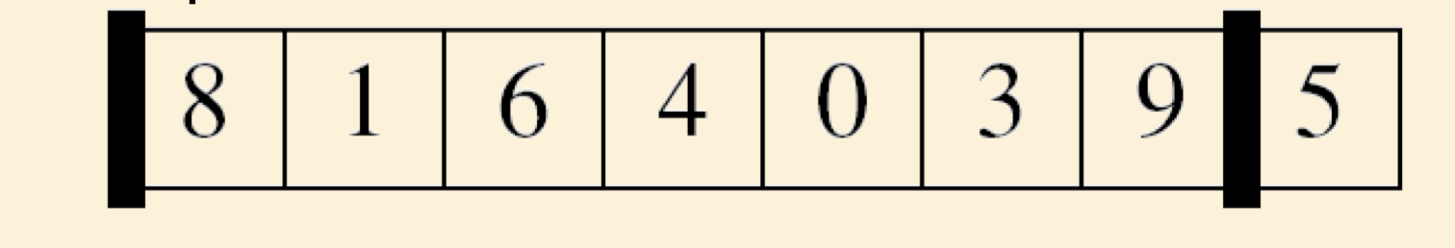



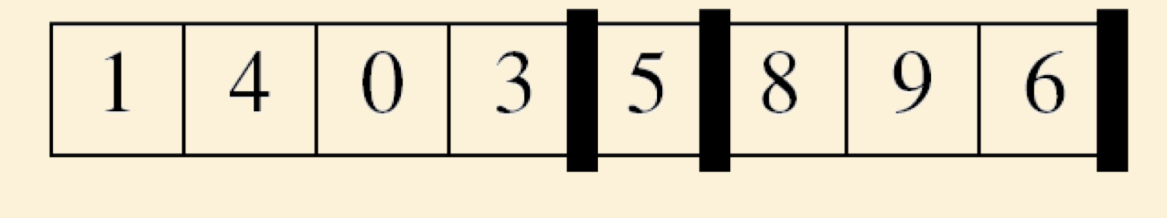
Precise Specification
p
r
p
q
r

Slide 57
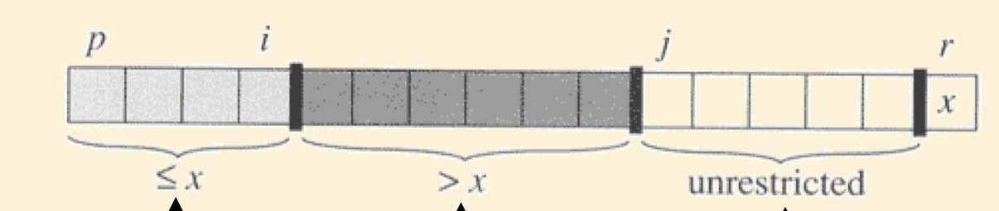
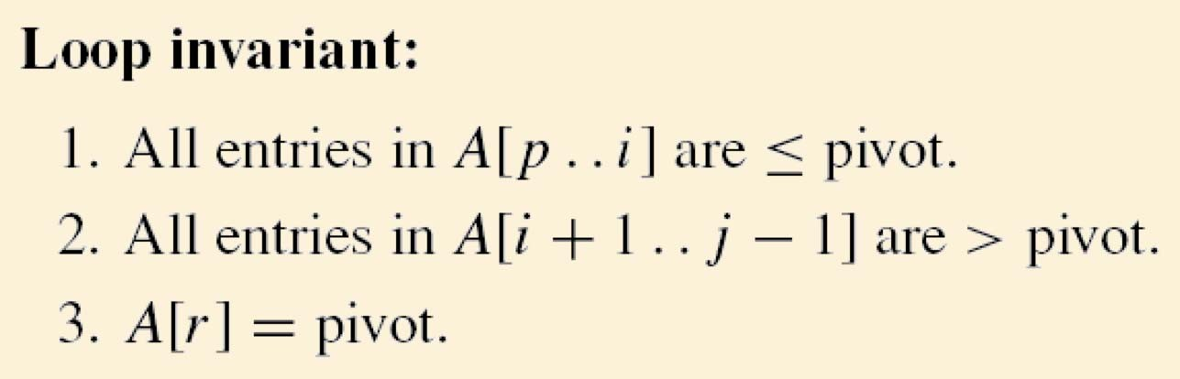
Loop Invariant
3 subsets are maintained
One containing values less than or equal to the pivot
One containing values greater than the pivot
One containing values yet to be processed

Slide 58
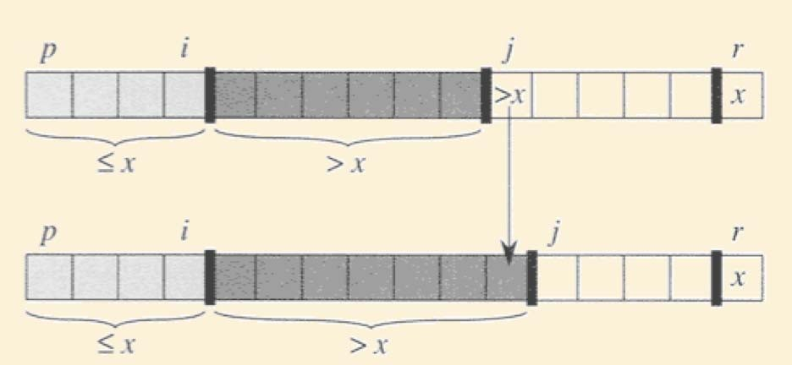
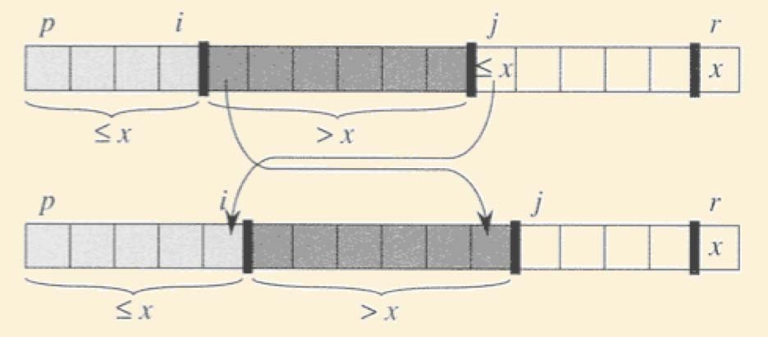
Maintaining Loop Invariant
Consider element at location j
– If greater than pivot, incorporate into ‘> set’ by incrementing j.
If less than or equal to pivot, incorporate into ‘S set’ by swapping with element at location i+1 and incrementing both i and j.
Measure of progress: size of unprocessed set.

Slide 59
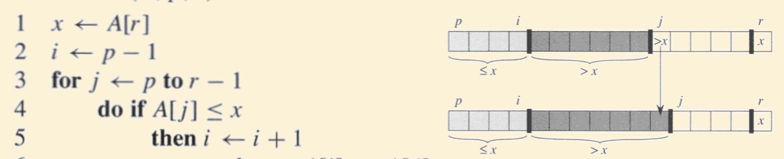
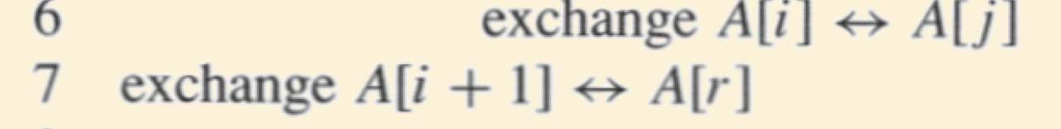
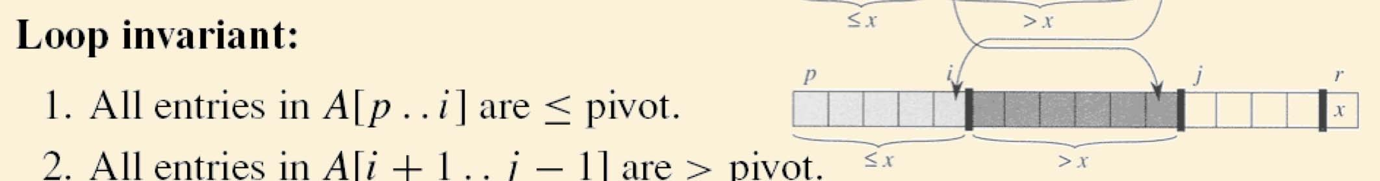
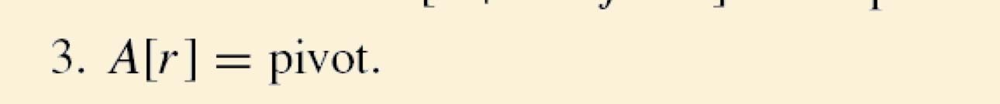

Maintaining Loop Invariant

Slide 60
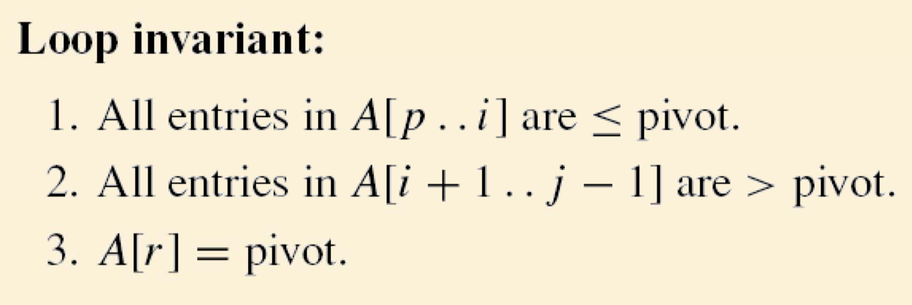
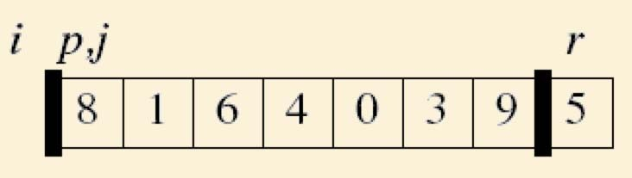
Establishing Loop Invariant

Slide 61
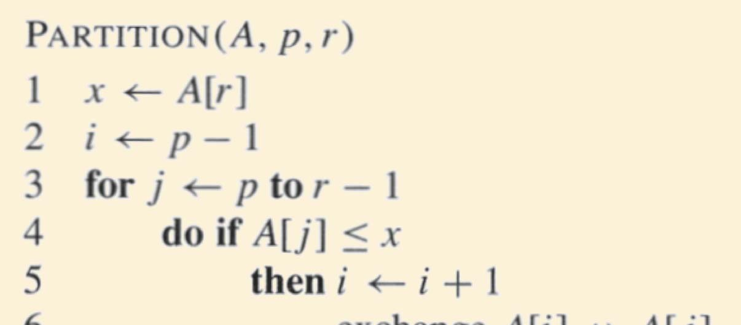
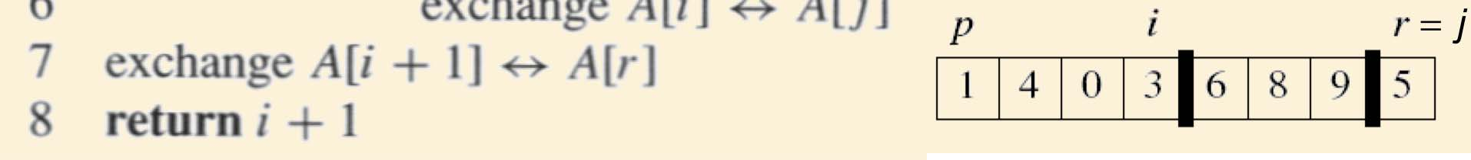
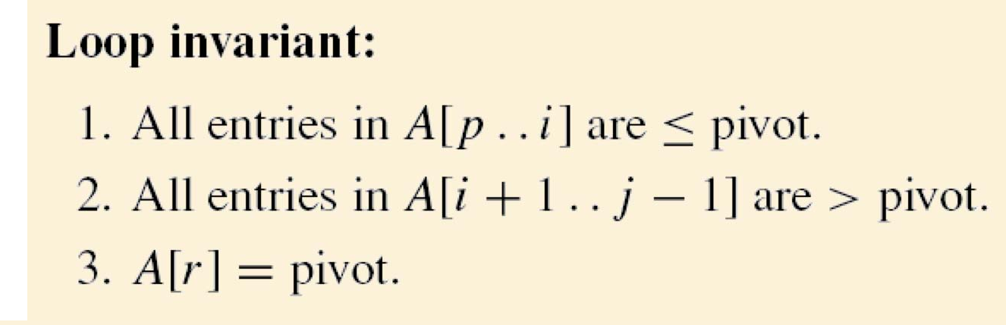
Establishing Postcondition
Exhaustive on exit

Slide 62
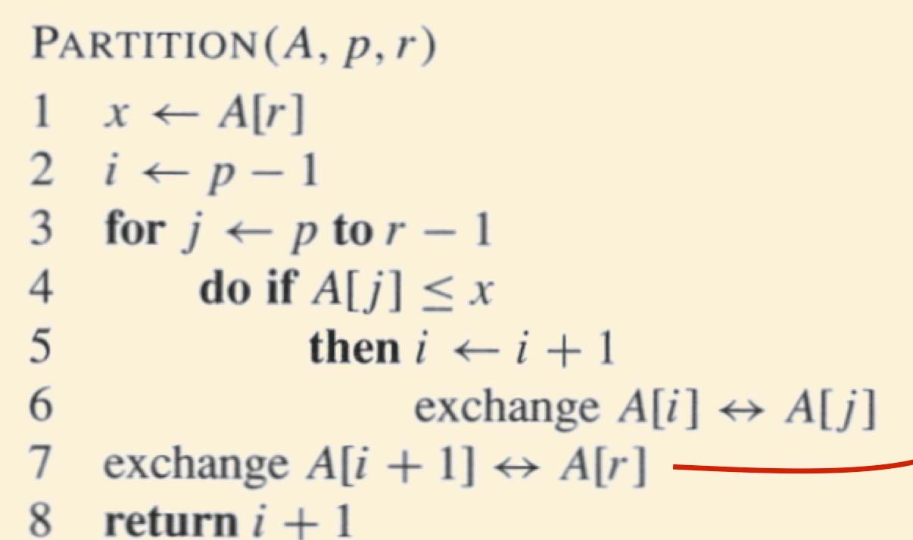
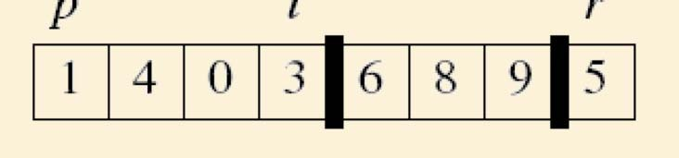
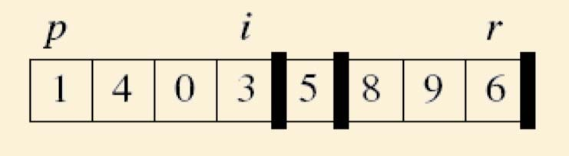
Establishing Postcondition

Slide 63
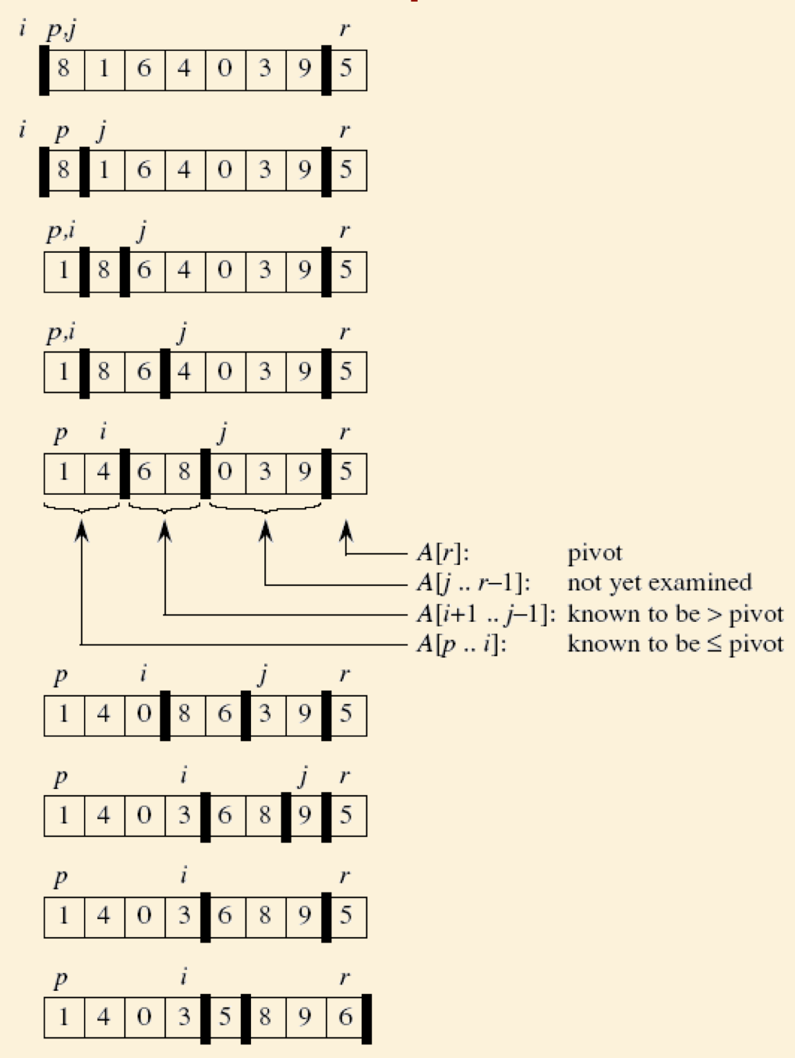
An Example

Slide 64
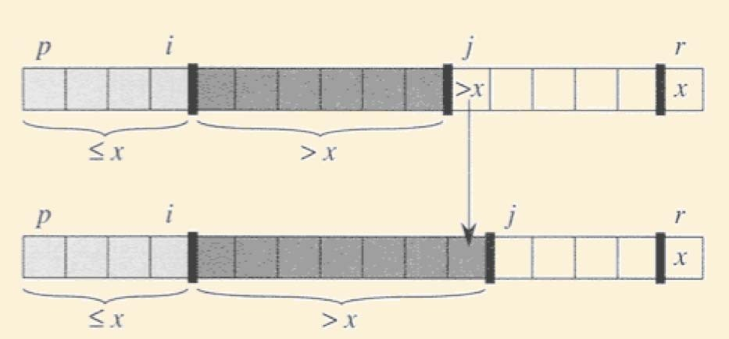

In-Place Partitioning: Running Time
Each iteration takes O(1) time €Total = O(n)
or

Slide 65
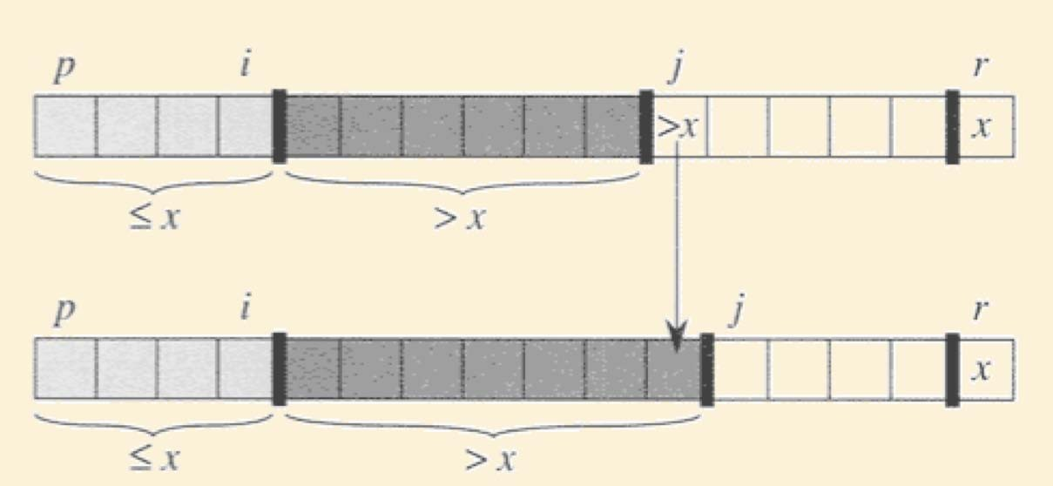

In-Place Partitioning is NOT Stable
or

Slide 66
The In-Place Quick-Sort Algorithm
Algorithm QuickSort(A, p, r) if p < r
q = Partition(A, p, r) QuickSort(A, p, q - 1) QuickSort(A, q + 1, r)

Slide 67
Running Time of Quick-Sort

Slide 68
Quick-Sort Running Time
We can analyze the running time of Quick-Sort using a recursion tree.
At depth i of the tree, the problem is partitioned into 2^{i} sub-problems.
The running time will be determined by how balanced these partitions are.
depth
0
1
… h

Slide 69
Quick Sort
Let pivot be the first
88 52
14
30
79
element in the list?
31 ₂₅ ₉₈
62
23
14
88
62
98
52 79
30
23
≤ 31 ≤
25

Slide 70
Quick Sort
14,23,25,30,31,52,62,79,88,98
≤ 14 ≤ 23,25,30,31,52,62,79,88,98
If the list is already sorted,
then the list is worst case unbalanced.

Slide 71
QuickSort: Choosing the Pivot
Common choices are:
random element
middle element
median of first, middle and last element

Slide 72






Best-Case Running Time
The best case for quick-sort occurs when each pivot partitions the array in half.
Then there are O(log n) levels
There is O(n) work at each level
Thus total running time is O(n log n)
depth time
0 n
1 n
… …
i n
… …
log n n

Slide 73
Quick Sort
Best Time:
T(n) = 2T(n/2) + →(n)
= →(n log n)
Worst Time:
Expected Time:

Slide 74
Worst-case Running Time
The worst case for quick-sort occurs when the pivot is the unique minimum or maximum element
One of L and G has size n – 1 and the other has size 0
The running time is proportional to the sum
n + (n – 1) + … + 2 + 1
Thus, the worst-case running time of quick-sort is O(n²)
depth time
0 n
1 n – 1
…
…
n – 1 1

Slide 75
Average-Case Running Time
If the pivot is selected randomly, the average-case running time for Quick Sort is O(n log n).
Proving this requires a probabilistic analysis.
We will simply provide an intution for why average-case O(n log n) is reasonable.
depth
0
1
… h

Slide 76

Expected Time Complexity for Quick Sort
Q: Why is it reasonable to expect O (n log n) time complexity?

Slide 77
Expected Time Complexity for Quick Sort
Then T (n) = T (p(n − 1)) +T (q(n − 1)) + O (n)
wlog, suppose that q > p.
Let k be the depth of the recursion tree Then q^{k}n = 1 → k = log n / log(1 / q)
Thus k χO (log n):
O (n) work done per level → T (n) = O (n log n).

Slide 78

Properties of QuickSort
In-place?
Stable?
Fast?
✓
✓
Depends.
Worst Case:
Expected Case:

Slide 79
Summary of Comparison Sorts
Algorithm | Best Case | Worst Case | Average Case | In Place | Stable | Comments
Selection | _{n}2 | _{n}2 |  | Yes | Yes
Bubble | n | _{n}2 |  | Yes | Yes
Insertion | n | _{n}2 |  | Yes | Yes | Good if often almost sorted
Merge | n log n | n log n |  | No | Yes | Good for very large datasets that require swapping to disk
Heap | n log n | n log n |  | Yes | No | Best if guaranteed n log n required
Quick | n log n | _{n}2 | n log n | Yes | No | Usually fastest in practice

Slide 80
Comparison Sort: Lower Bound
MergeSort and HeapSort are both 0(n log n) (worst case).
Can we do better?

Slide 81
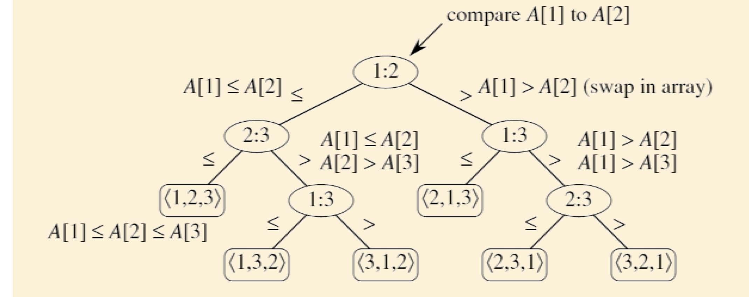
Comparison Sort: Decision Trees
Example: Sorting a 3-element array A[1..3]

Slide 82
Comparison Sort: Decision Trees
For a 3-element array, there are 6 external nodes.
For an n-element array, there are n! external nodes.

Slide 83
Comparison Sort
To store n! external nodes, a decision tree must have a height of at least ϑ|log n!]|
Worst-case time is equal to the height of the binary decision tree.
Thus T (n) χφι(log n!)
n
|⎝n / 2|]
where log n! = ∴log i Σ ∴ log |⎝n / 2|] χφι(n log n)
i =1 i =1
Thus T (n) χφι(n log n)
Thus MergeSort & HeapSort are asymptotically optimal.

Slide 84
Searching and Sorting
Linear Search
Binary Search

Slide 85
Linear Search
Searching is the process of determining whether or not a given value exists in a data structure or a storage media.
We discuss two searching methods on one-dimensional arrays: linear search and binary search.
The linear (or sequential) search algorithm on an array is:
Sequentially scan the array, comparing each array item with the searched value.
If a match is found; return the index of the matched element; otherwise return –1.
Note: linear search can be applied to both sorted and unsorted arrays.

Slide 86
Linear Search
The algorithm translates to the following C method:
// Linear Search in C
#include <stdio.h>
int search(int array[], int n, int x) {
// Going through array sequencially
for (int i = 0; i < n; i++)
if (array[i] == x)
return i;
return -1;
}

Slide 87
Linear Search
int main() {
int array[] = {2, 4, 0, 1, 9};
int x = 1;
int n = sizeof(array) / sizeof(array[0]);
int result = search(array, n, x);
(result == -1) ? printf("Element not found") : printf("Element found at index: %d", result);
}

Slide 88
Binary Search
Binary search uses a recursive method to search an array to find a specified value
The array must be a sorted array:
a[0]≤a[1]≤a[2]≤. . . ≤ a[finalIndex]
If the value is found, its index is returned
If the value is not found, -1 is returned
Note: Each execution of the recursive method reduces the search space by about a half

Slide 89
BinarySearch
An algorithm to solve this task looks at the middle of the array or array segment first
If the value looked for is smaller than the value in the middle of the array
Then the second half of the array or array segment can be ignored
This strategy is then applied to the first half of the array or array segment

Slide 90
Binary Search
If the value looked for is larger than the value in the middle of the array or array segment
Then the first half of the array or array segment can be ignored
This strategy is then applied to the second half of the array or array segment
If the value looked for is at the middle of the array or array segment, then it has been found
If the entire array (or array segment) has been searched in this way without finding the value, then it is not in the array

Slide 91
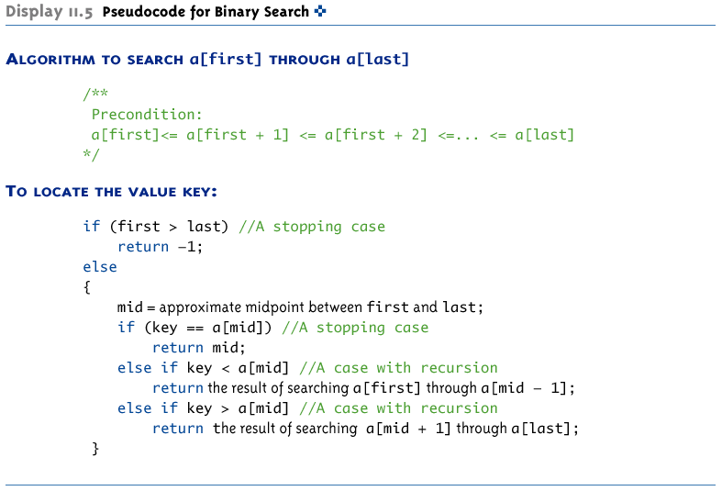
Pseudocode for Binary Search

Slide 92
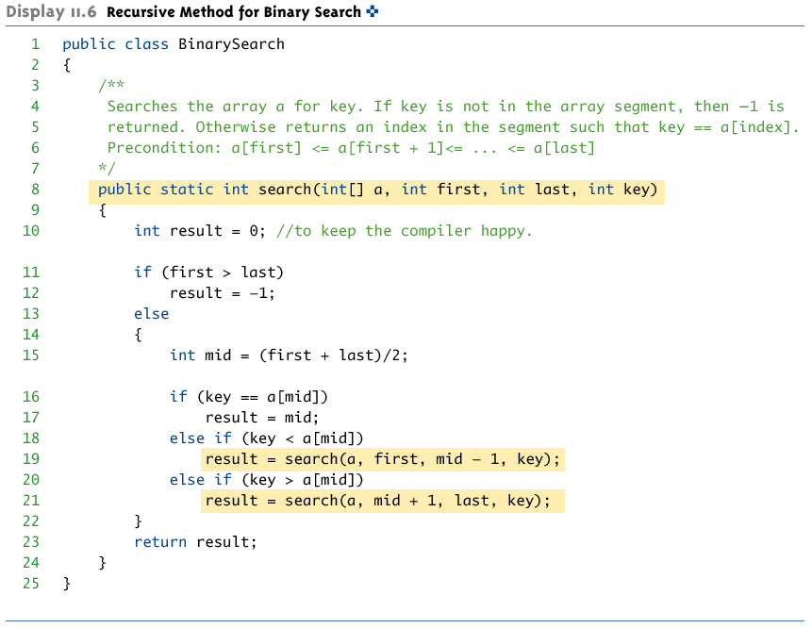
Recursive Method for Binary Search

Slide 93
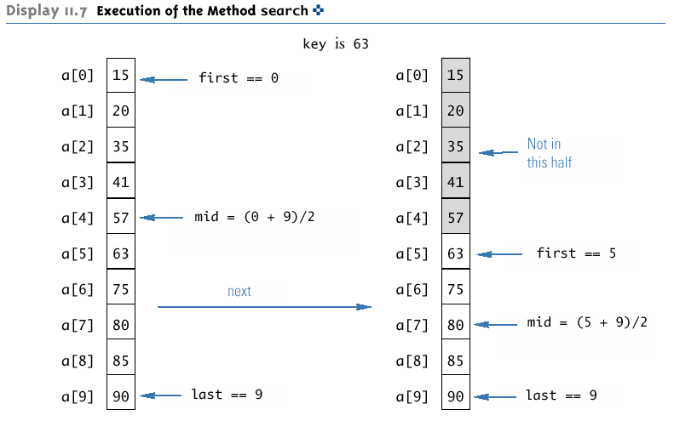
Execution of the Method search (Part 1 of 2)

Slide 94

Execution of the Method search (Part 1 of 2)

Slide 95
Checking the search Method
There is no infinite recursion
On each recursive call, the value of first is increased, or the value of last is decreased
If the chain of recursive calls does not end in some other way, then eventually the method will be called with first larger than last
Each stopping case performs the correct action for that case
If first > last, there are no array elements between a[first] and a[last], so key is not in this segment of the array, and result is correctly set to -1
If key == a[mid], result is correctly set to mid

Slide 96
Checking the search Method
For each of the cases that involve recursion, if all recursive calls perform their actions correctly, then the entire case performs correctly
If key < a[mid], then key must be one of the elements a[first] through a[mid-1], or it is not in the array
The method should then search only those elements, which it does
The recursive call is correct, therefore the entire action is correct

Slide 97
Checking the search Method
If key > a[mid], then key must be one of the elements a[mid+1] through a[last], or it is not in the array
The method should then search only those elements, which it does
The recursive call is correct, therefore the entire action is correct
The method search passes all three tests:
Therefore, it is a good recursive method definition

Slide 98
Efficiency of Binary Search
The binary search algorithm is extremely fast compared to an algorithm that tries all array elements in order
About half the array is eliminated from consideration right at the start
Then a quarter of the array, then an eighth of the array, and so forth

Slide 99
Efficiency of Binary Search
Given an array with 1,000 elements, the binary search will only need to compare about 10 array elements to the key value, as compared to an average of 500 for a serial search algorithm
The binary search algorithm has a worst-case running time that is logarithmic: O(log n)
A serial search algorithm is linear: O(n)
If desired, the recursive version of the method search can be converted to an iterative version that will run more efficiently

Slide 100

Iterative Version of Binary Search (Part 1 of 2)

Slide 101

Iterative Version of Binary Search (Part 2 of 2)

